Slide 1
Cricket score sheet system
Presented By: Swarup Dahal

Slide 2
Cricket score sheet system
As we all know, cricket is a world wide played game between two teams and each team consists of eleven players.
Cricket is played in pitch and it contains bat, ball and wickets.
There are certain rules of cricket like four, six, out, no ball, wide ball, dead ball, etc.
Cricket score sheet system contains the all details of the match played.
It contains format of game played, total run of teams and run scored by a player.

Slide 3
Objectives
To create a proper score sheet for cricket that allows to record the score of a team.
To make user easy to understand the summary of the game.
To check the performance of team and individual player of a team.

Slide 4
Key features are :
Allows to enter the name and score of the cricket team.
Allows to enter the format in which cricket will be played.
Allows to record the name of player and run scored by the player .
Allows to record overs done by a single player.
Allows to record extra runs also.
Allows to record fours and six hit by the player.
Output will be total run of the team and overall summary of the game.

Slide 5
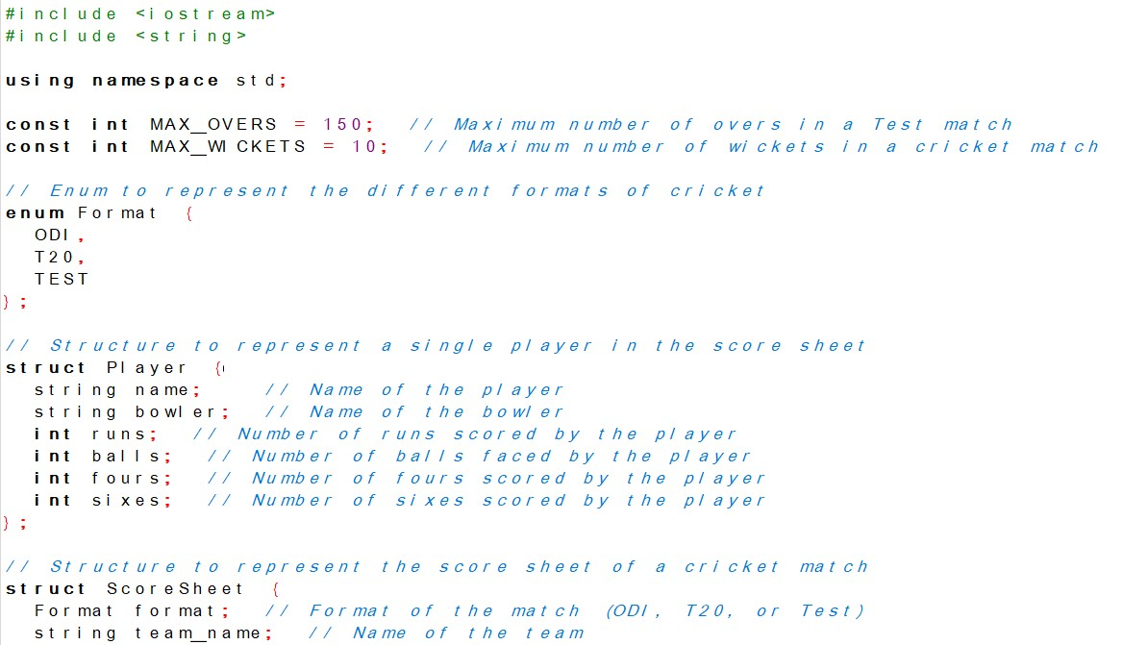
For implementing the features in c++ I included the header files like iostream and string. I created the enum to declare format in which game can be played.

Slide 6
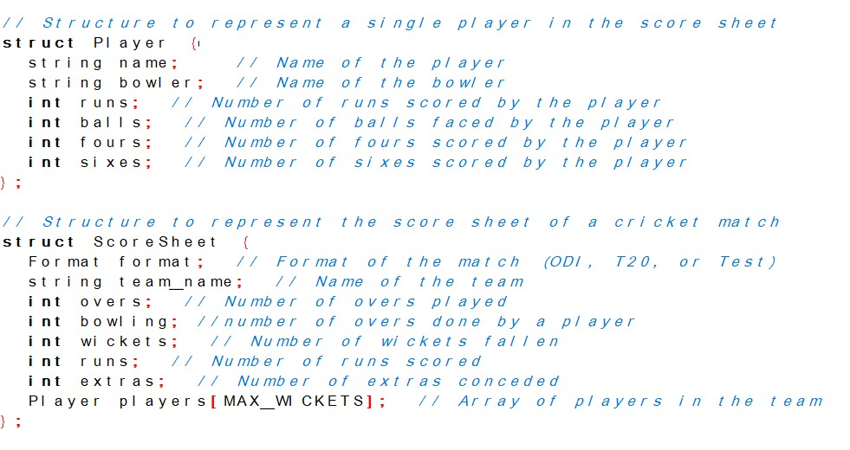
I also create the structure to represent single player and to represent the scoresheet.

Slide 7
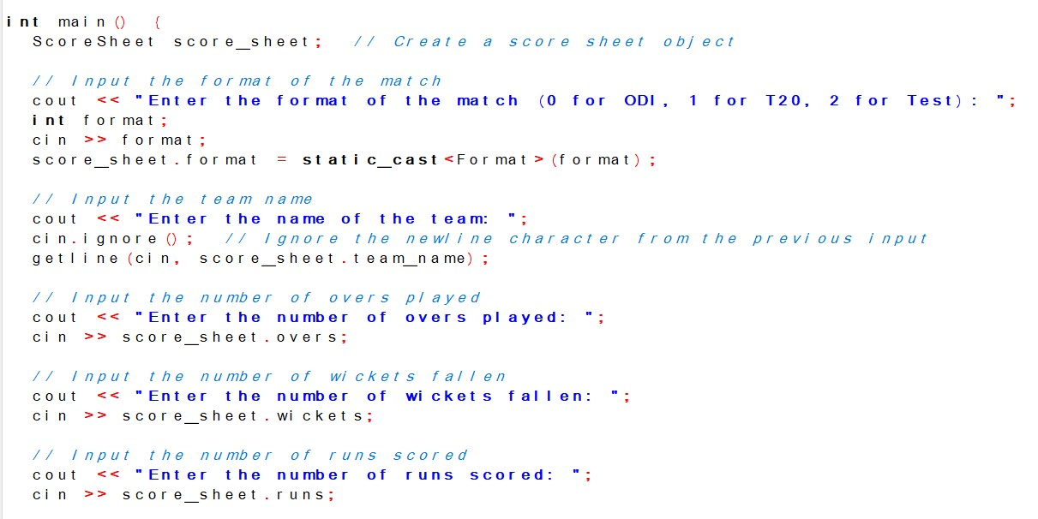
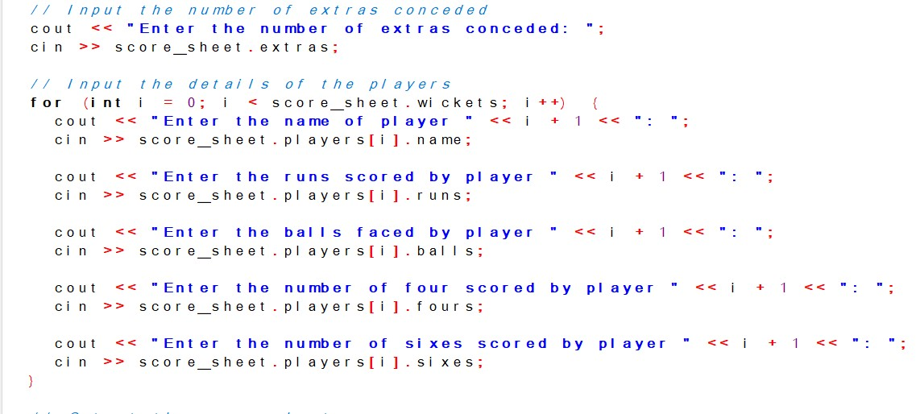
I have taken all the input in the main method by calling the data members created in the previous structure.

Slide 8
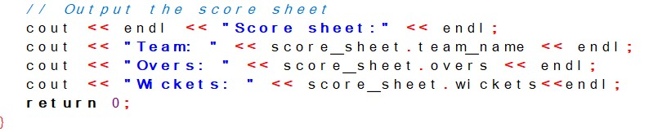
Output code for the score sheet is written like this

Slide 9
Challenges with their overcomes
One of the challenge while writing the code was declare the overs for the bowlers which is still not solved.
Another problem was to record everything in a single system so I used the for loop to record everything.
Other challenge was to make the score sheet easy to understand so I displayed the overall summary of the match and still something are remained to display.
Testing and debugging of the code is necessary so that the score sheet runs properly

Slide 10
What’s left?
Code for records of bowlers are still left to enter.
Output for total summary is still left to code.

Slide 11
Conclusion
The score sheet will be created using C++ implementing the give above features.
Left portion will be included soon.
This projects helps to create score sheet for cricket and helps to record the score of the match.
It helps to summarize the overall performance of team an every player

Slide 12

THANK YOU

